Slide 1

Introduction to OOP in C++
1
IT 2022: Object Oriented Programming
Sandali Goonatilleke
Department of Computer Engineering

Slide 2
Module Overview
Module Name: Object Oriented Programming
Module Code: IT 2022
Number of Credits: 2
Method of Assessment
Continuous Assessment – 30%
Final Written Exam – 70%

Slide 3

Module Content
Introduction to Object-Oriented Programming in C++
Classes & Objects
Constructors & Destructors
Class Abstraction and Encapsulation
Composition
Inheritance
Polymorphism

Slide 4

Overview
Programming Languages
Machine Language
Assembly Language
Programming Language
Procedure Oriented Programming (POP)
Introduction to OOP
Advantages of OOP
Concepts of OOP

Slide 5
Programming Languages
Programmers write instructions in various programming languages to perform their computation tasks.
Examples:
Machine level Language
Assembly level Language
High level Language

Slide 6

Machine Language
Machine language is a low-level language
Also known as machine code or object code
Made up of binary numbers or bits that a computer can understand
This language is extremely tough to comprehend

Slide 7
Machine Language
The only language that the computer understands is machine language
A set of instructions executed directly by a computer's central processing unit (CPU)
Each instruction performs a very specific task, such as a load, a jump, or an ALU operation on a unit of data in a CPU register or memory

Slide 8
Assembly Language
An assembly language or assembler language
A low-level programming language for a computer, or other programmable device
Has a very strong correspondence between the language and the architecture's machine code instructions
It is converted into executable machine code by a utility program referred to as an assembler
The conversion process is referred to as assembly, or assembling the code

Slide 9
Exercise 1
Compare and contrast machine level language and assembly language

Slide 10
Exercise 1
Machine Language | Assembly Language
Only understand by the computers | Only understand by human beings not by the computers
Data only represented with the help of binary format (0s and 1s), hexadecimal and octadecimal | Data can be represented with the help of mnemonics such as Mov, Add, Sub, End etc
Very difficult to understand and memorize by the human beings | Easy to understand and memorize by the human being
Execution is fast | Execution is slow

Slide 11
High-Level Language
Any programming language that enables development of a program in much simpler programming context and is generally independent of the computer's hardware architecture
The first high-level programming languages were designed in the 1950s.
There are dozens of different languages, including Ada, Algol, BASIC, COBOL, C, C++, JAVA, FORTRAN, LISP, Pascal, and Prolog

Slide 12
High-Level Language
Such languages are considered high-level because they are closer to human languages and farther from machine languages
In contrast, assembly languages are considered low level because they are very close to machine languages
The high-level programming languages are broadly categorized into two categories
- Procedure Oriented Programming (POP) Language
- Object Oriented Programming (OOP) Language

Slide 13
Exercise 2
Compare and contrast machine level language and high-level language
Compare and contrast assembly language and high -level language

Slide 14
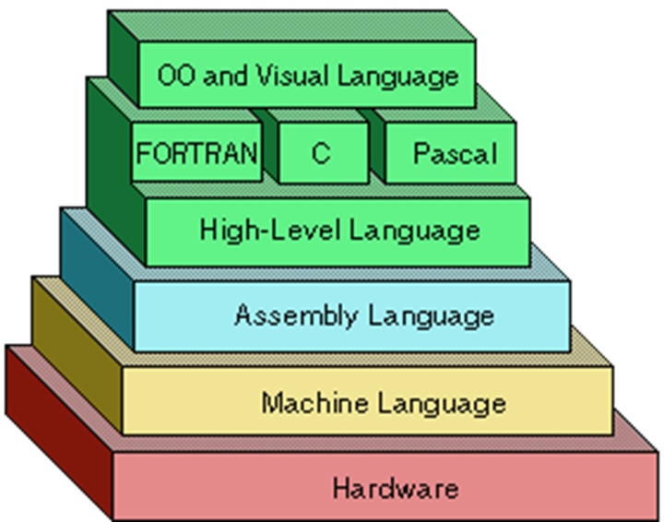
Programming Language Generations
This classification is used to indicate increasing power of programming styles
First-generation programming languages
Second-generation programming languages
Third-generation programming languages
Fourth-generation programming languages
Fifth-generation programming languages

Slide 15
First-generation programming language (1GL)
Machine-level programming language
Translator isn’t used to compile
The instructions in 1GL are made of binary numbers, represented by 1s and 0s
Advantage
  The code can run very fast and very efficiently because the instructions are executed directly by the CPU
Disadvantage
  When an error occurs, the code is not as easy to fix

Slide 16
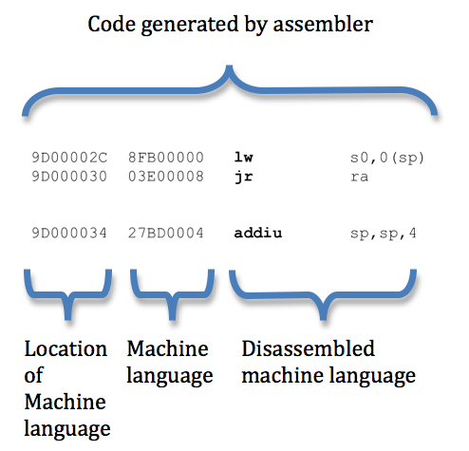
Second-generation programming language (2GL)
Assembly language
Properties
  The code can be read and written by a programmer
  The language is specific to a particular processor family and environment
Used in kernels and device drivers

Slide 17
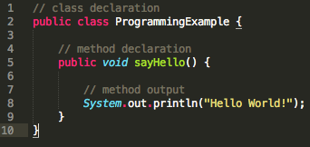
Third-generation programming language (3GL)
Languages are more programmer-friendly
Example
  C, C++, C#, Java, BASIC and Pascal
Support structured programming
Must be translated into machine language by a compiler or interpreter
Advantages
  Easier to read, write, and maintain

Slide 18
Fourth-generation programming language (4GL)
Designed to reduce programming effort
Consist of
  Set of libraries
  CRUD generators
  Report generators
  DBMS
  Visual design tool and integration API
Different types of 4GLs
  Table-driven (codeless) programming
    PowerBuilder
  Data management
    SAS, SPSS
  Report-generator programming languages
    Oracle Developer Suite

Slide 19
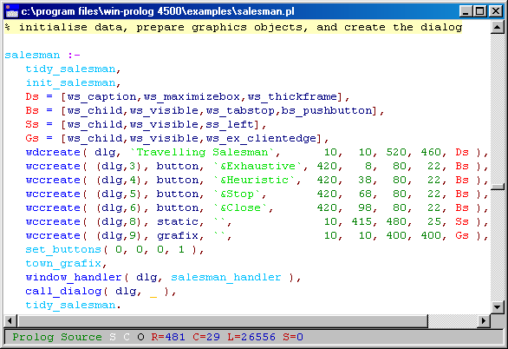
Fifth-Generation Programming Languages (5GL)
Based on solving problems using constraints given to the program, rather than using an algorithm written by a programmer
Use mainly in Artificial Intelligence research
Example
  Prolog, OPS5, and Mercury

Slide 20
High-Level Languages
Broadly categorized into two categories
Procedure Oriented Programming (POP) Language
Object Oriented Programming (OOP) Language

Slide 21
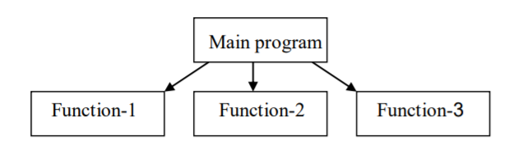
Procedure Oriented Programming (POP)
In the procedure-oriented approach, the problem is viewed as sequence of things to be done (reading, calculation and printing)
Basically consists a list of instruction or actions for the computer to follow and organizing these instruction into groups known as functions

Slide 22
Procedure Oriented Programming (POP)
Characteristics of procedure-oriented programming:
Emphasis is on doing things (algorithm)
Large programs are divided into smaller programs known as functions
Most of the functions share global data
Data move openly around the system from function to function
Function transforms data from one form to another Employs top-down approach in program design

Slide 23
Procedure Oriented Programming (POP)
The disadvantage of the procedure-oriented programming languages
Global data access
It does not model real word problem very well
No data hiding

Slide 24
What is OOP?
Stands for Object-Oriented Programming
Object-oriented programming (OOP) is a
programming paradigm that represents concepts
as "objects" that have data fields (State) and
methods (Behavior)
As the name suggests uses objects in programming

Slide 25
Advantages of OOP
Object-oriented programming has several advantages over procedural programming:
Provides a clear modular structure for programs
Faster and easier to execute
Makes the code easier to maintain, modify and debug
Makes it possible to create full reusable applications with less code and shorter development time

Slide 26
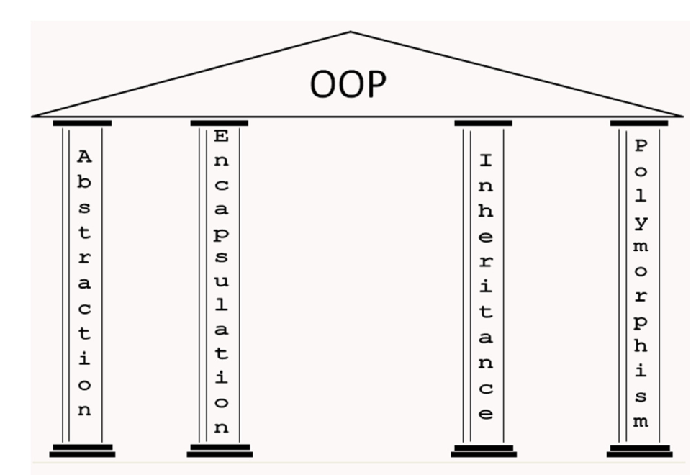
Concepts of OOP
Objects
Classes
Encapsulation
Inheritance
Polymorphism
Data Abstraction

Slide 27
What is an Object?
Object is a software bundle of related state
and behavior
It is the basic unit of object-oriented programming
Is an instance of a Class
Characteristics: state and behavior
- States: What the objects have
- Behaviors: What the objects do

Slide 28

What is an Object?
Example (Person)
- State (Name, NIC, Height)
- Behavior (Speech, Sleep, Eat)

Slide 29

What is an Object?
Example (Dog)
- State (Name, Color, Breed)
- Behavior (Barking, Eating, Wagging the tail)

Slide 30
What is a Class?
A group of objects that share common properties for data part and some program part are collectively called as class
A user-defined data type, which holds its own data and functions
A class is like a blueprint for an object

Slide 31
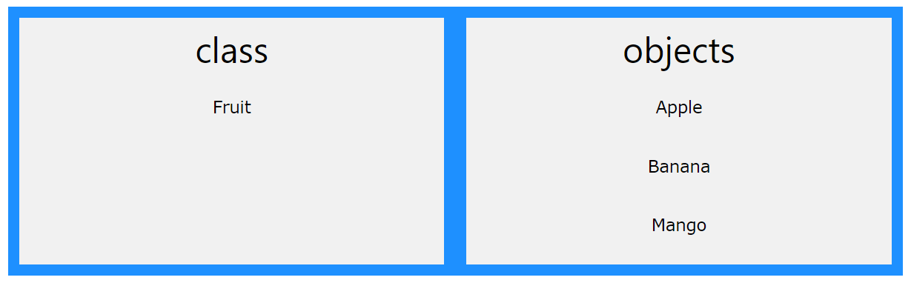
Relationship between Class and Objects

Slide 32
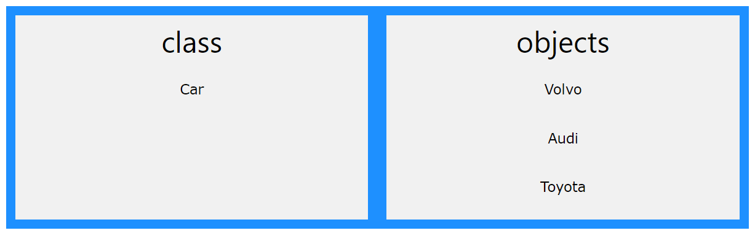
Relationship between Class and Objects

Slide 33
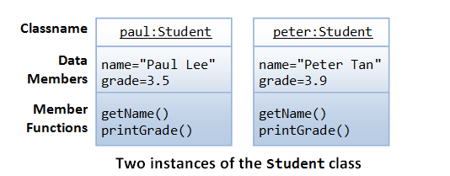
Definition: Object

Slide 34
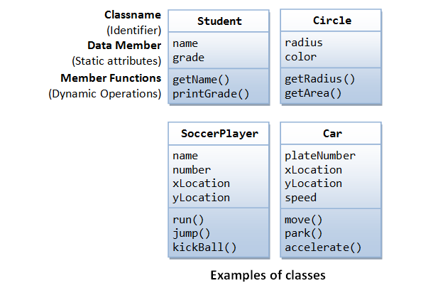
Definition: Class

Slide 35
Homework
Compare and Contrast POP and OOP

Slide 36
Thank You!

